Slide 1
Vehicle and Traffic Signs Detection using YOLOv5

Slide 2
CONTENTS
Introduction
Background
Design and Implementation
Result
Conclusion

Slide 3
Introduction
1

Slide 4
INTRODUCTION
YOLO an acronym for 'You only look once’
YOLOv5 is one of the most famous object detection algorithms due to its speed and accuracy in real-time detection

Slide 5
Background
2

Slide 6
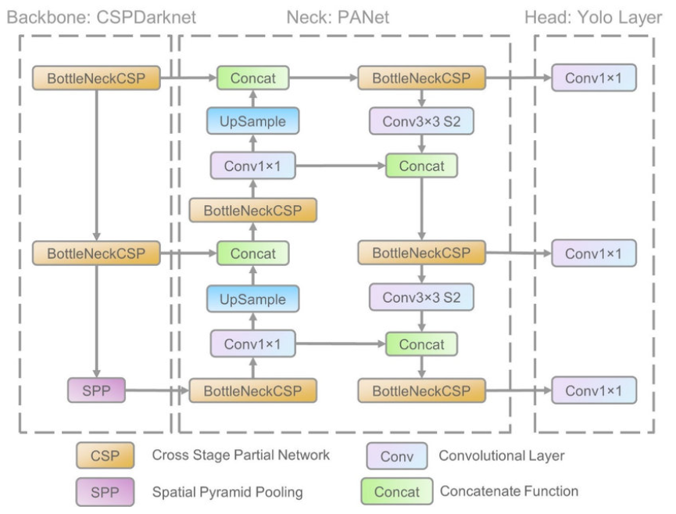
YOLOv5 MODULE ARCHITECHTURE
There are three module used in YOLO v5: Model Backbone, Model Neck, and Model Head.
Model Backbone is mainly used to extract important features from the given input image.
Model Neck is mainly used to generate feature pyramids.
The model Head is mainly used to perform the final detection part.

Slide 7
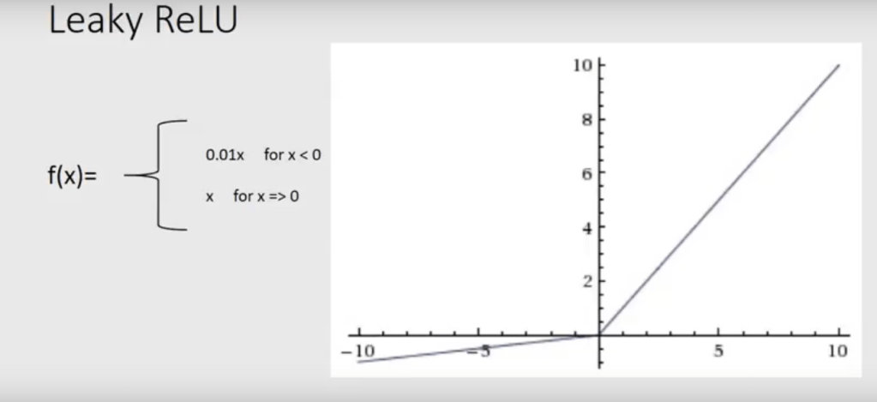

ACTIVATION FUNCTION
YOLO v5 authors decided to go with the Leaky ReLU and Sigmoid activation function.
Leaky ReLU activation function is used in middle/hidden layers
Sigmoid activation function is used in the final detection layer.

Slide 8
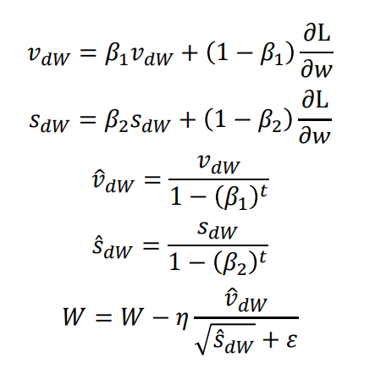
OPTIMIZATION
For optimization function in YOLO v5, we have two options:
SGD (Stochastic Gradient Descent)
Adam (Adaptive Moment Estimation).
Adam algorithm

Slide 9
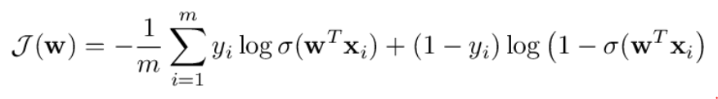
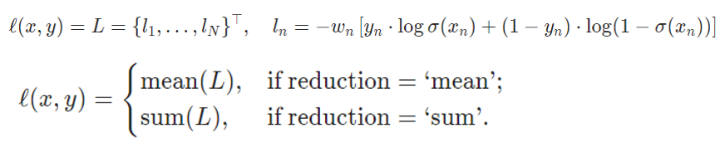
LOSS FUNCTION
There is a compound loss is calculated based on objectness score, class probability score, and bounding box regression score.
Binary Cross-Entropy
Logits Loss function

Slide 10
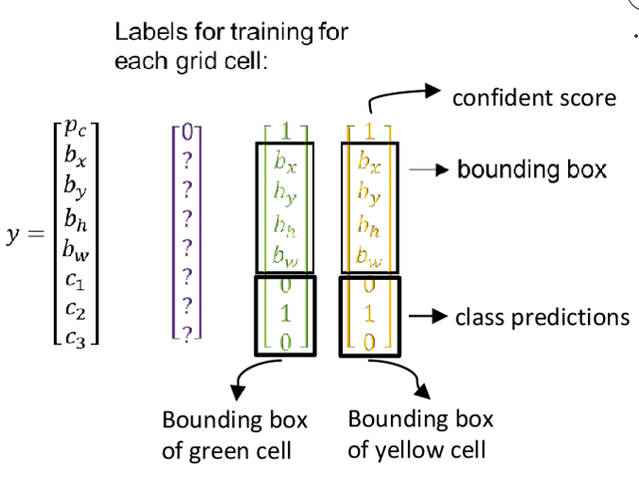
Logits Loss Function
Logits Loss in the case of multi-label classification
pc​​ is the weight of the positive answer for the class c, with pc​​ >1 increases the recall, pc​​ < 1 increases the precision.

Slide 11
Design and Implementation
3

Slide 12
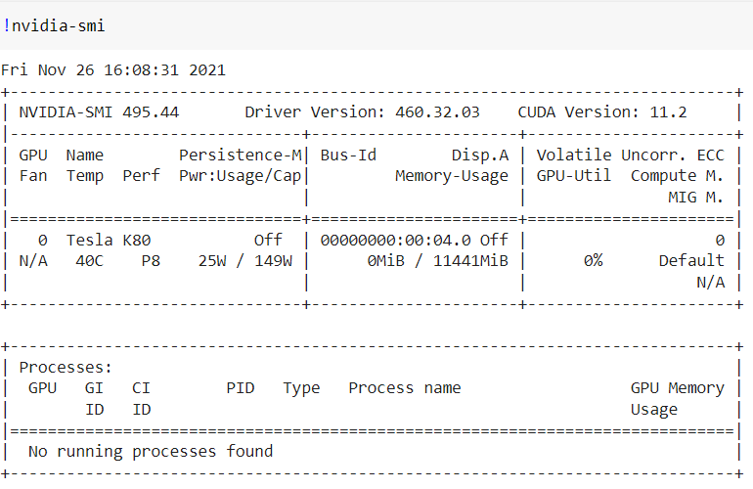
ENVIRONMENT
Google Colab (Google Collaboratory)
It is free to use Graphic Process Unit (GPU) and Tensor Process Unit (TPU)
Colab provides Tesla K80 GPU.

Slide 13
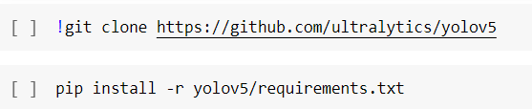
ENVIRONMENT
Ultralystic builds YOLOv5 on the PyTorch framework
Cloning and installing the YOLOv5 repository

Slide 14
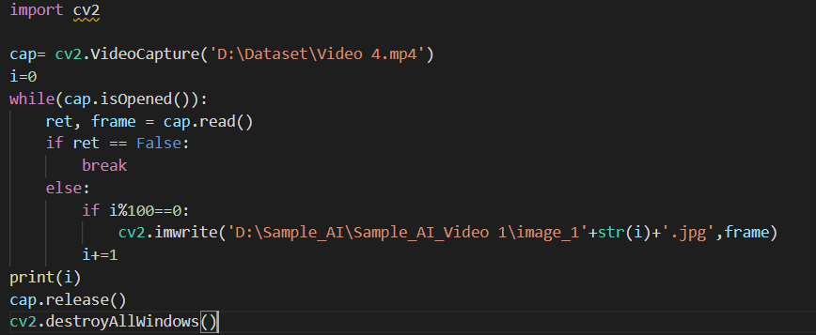
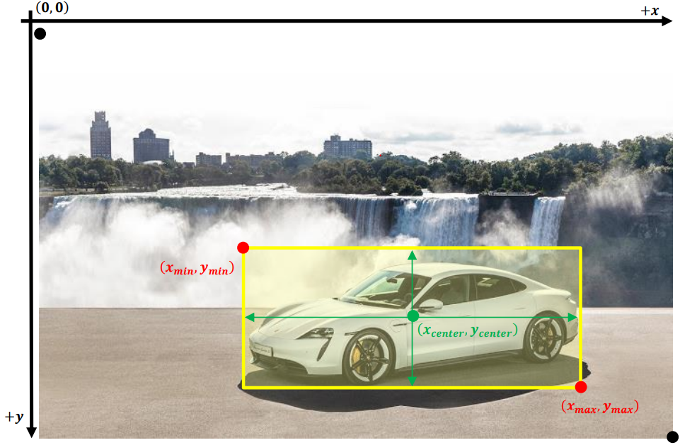
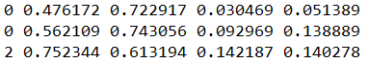
PREPARING THE DATASET FOR TRAINING
[𝑐𝑙𝑎𝑠𝑠, 𝑥𝑐𝑒𝑛𝑡𝑒𝑟, 𝑦𝑐𝑒𝑛𝑡𝑒𝑟, 𝑤𝑖𝑑𝑡ℎ, ℎ𝑒𝑖𝑔ℎ𝑡].

Slide 15
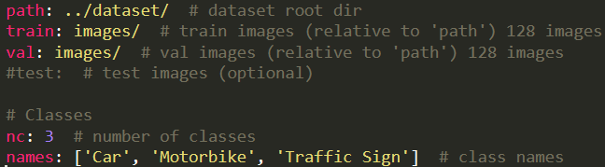
CREATING THE DATASET.YAML

Slide 16
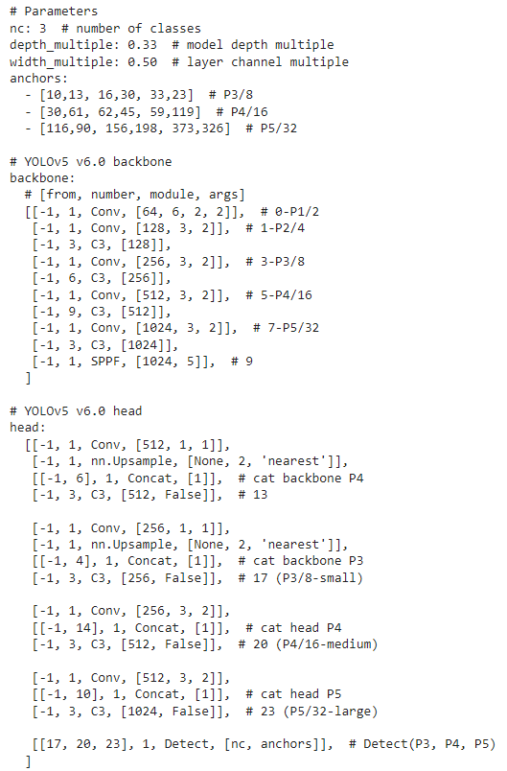
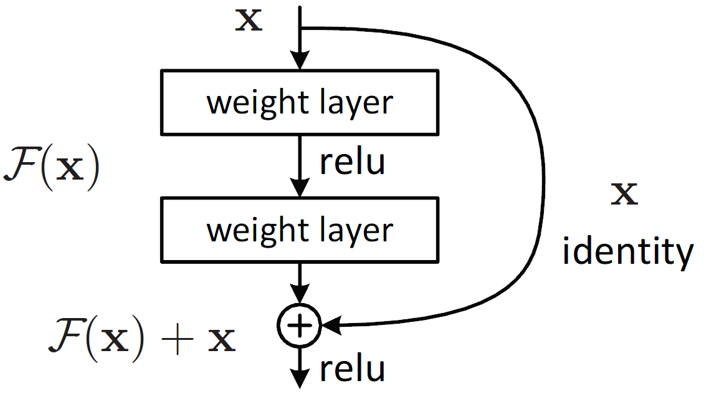
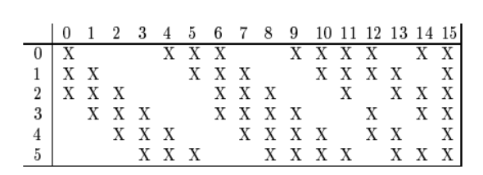
TRAINING PHASE
For the VTSD dataset, the number of classes needs to be adjusted, 3 classes especially.

Slide 17
TRAINING MODULE
img: define input image size. The original image size is 1280 × 720
batch: determine the batch size. The training set contains 2068 images, with 𝑏𝑎𝑡𝑐ℎ 𝑠𝑖𝑧𝑒 = 35. The number of batches will be 2068 ÷ 35 = 60 𝑏𝑎𝑡𝑐ℎ𝑒𝑠.
epochs: define the number of training epochs.
data: the path to datasets.yaml file .
cfg: specify our model configuration path.
weights: specify a path to weights

Slide 18
Result
4

Slide 19
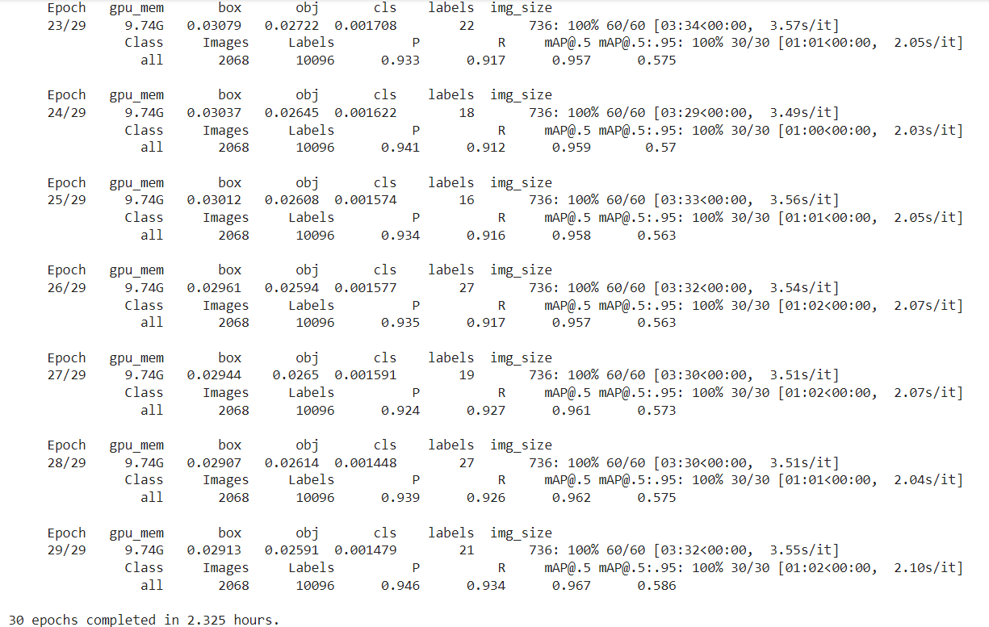
TRAINING PROGRESS IN 30 EPOCHES FIRST
For 1 epoch, the average time to perform the training process on 60 batches were 3 minutes 34 seconds and for evaluation on 30 batches were 1 minute 1 second
The total execution time was 2.325 hours for 30 epochs first on the dataset containing 2068 images and the mAP of last epoch is 96.7%.

Slide 20
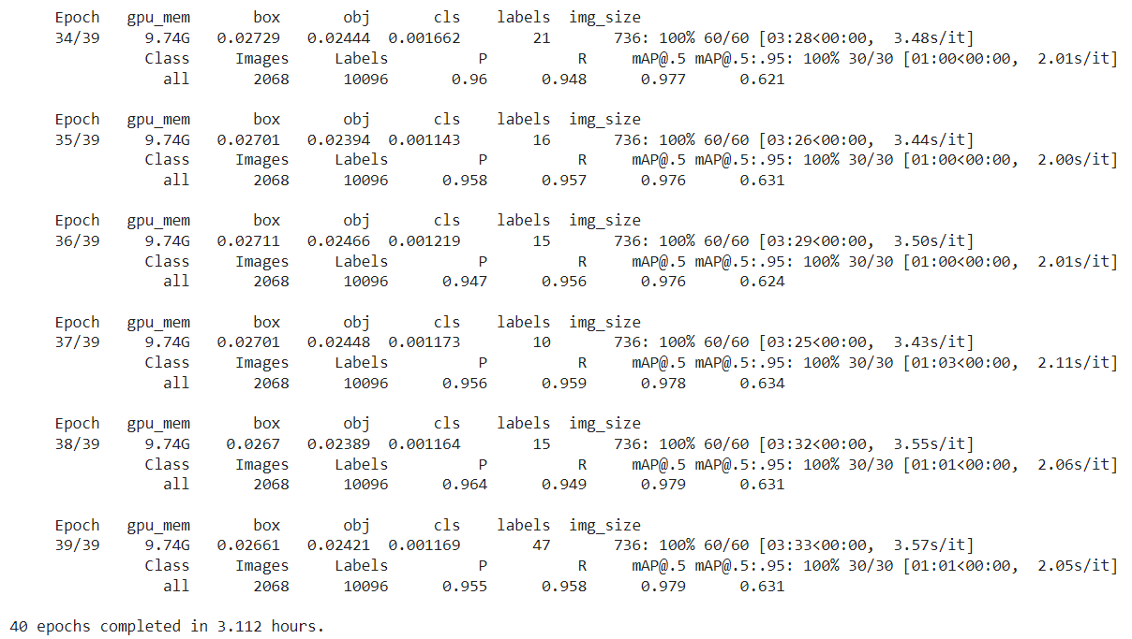
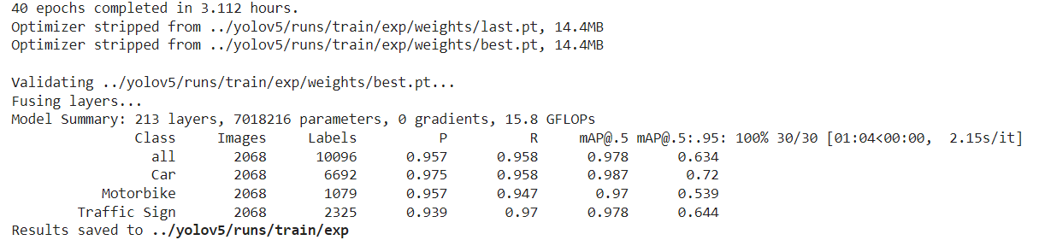
TRAINING PROGRESS IN 40 EPOCHES LATER
For 1 epoch, the average time to perform the training process on 60 batches were 3 minutes 33 seconds and for evaluation on 30 batches were 1 minute 1 second2
The total execution time was 3.112 hours for 40 epochs later on the dataset containing 2068 images and the mAP of last epoch is 97.9%.

Slide 21
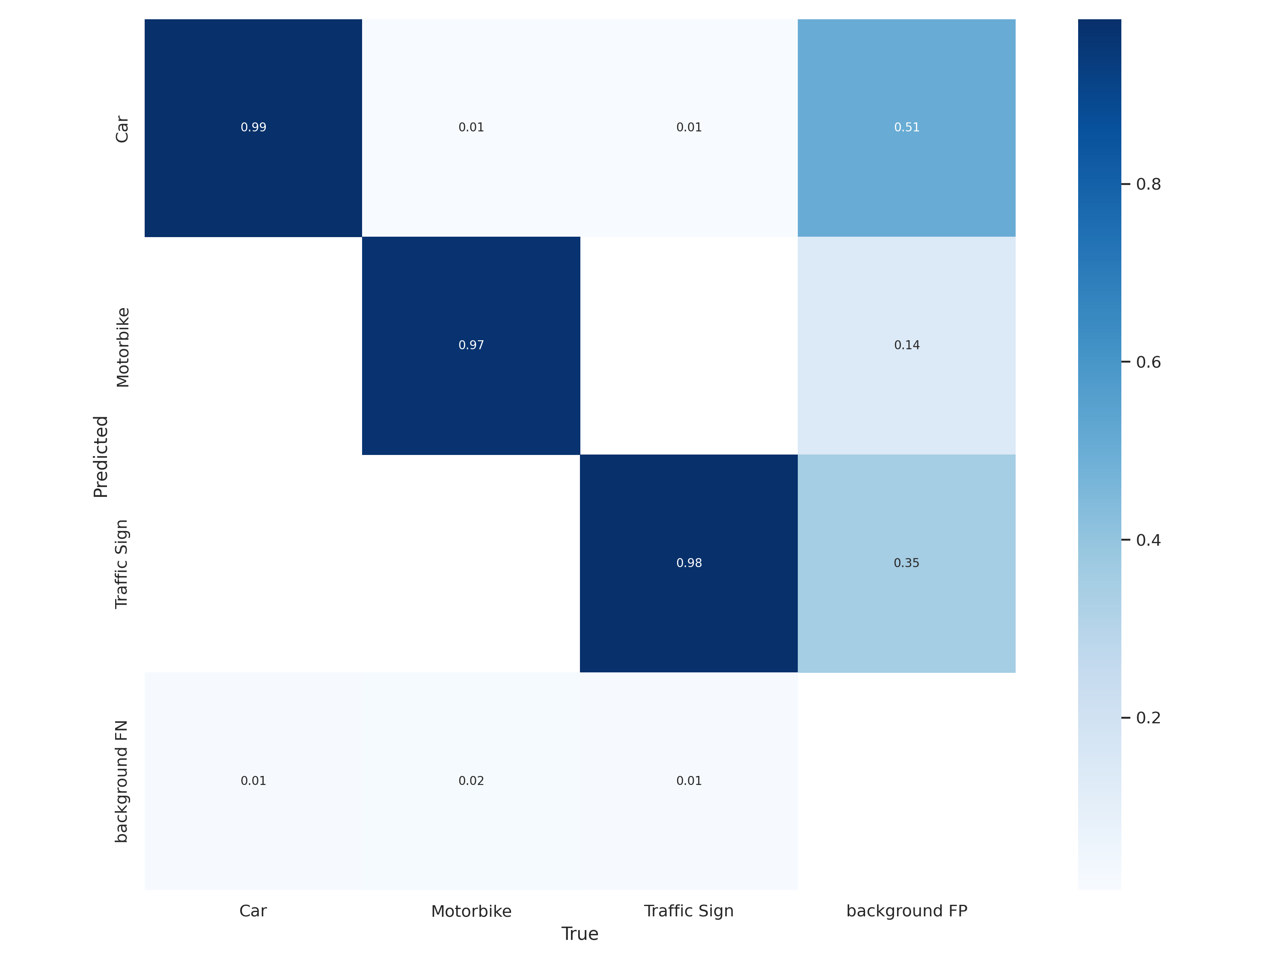
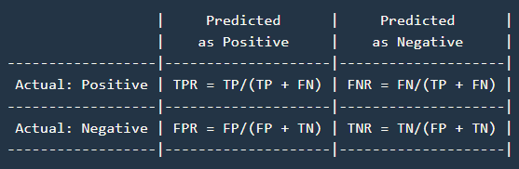
CONFUSION MATRIX
normalized confusion matrix

Slide 22
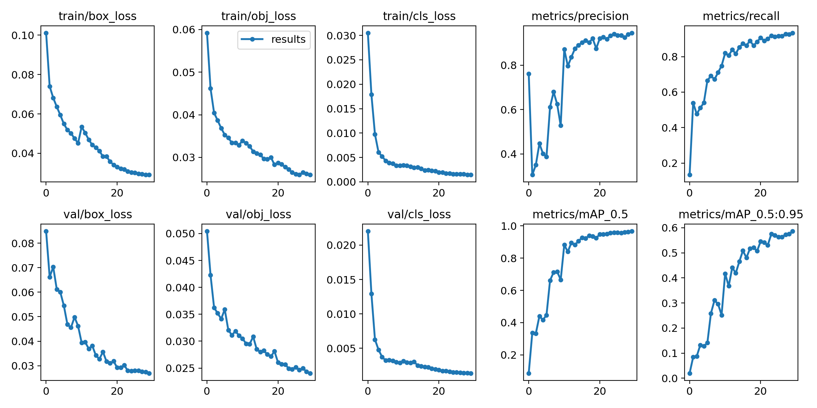
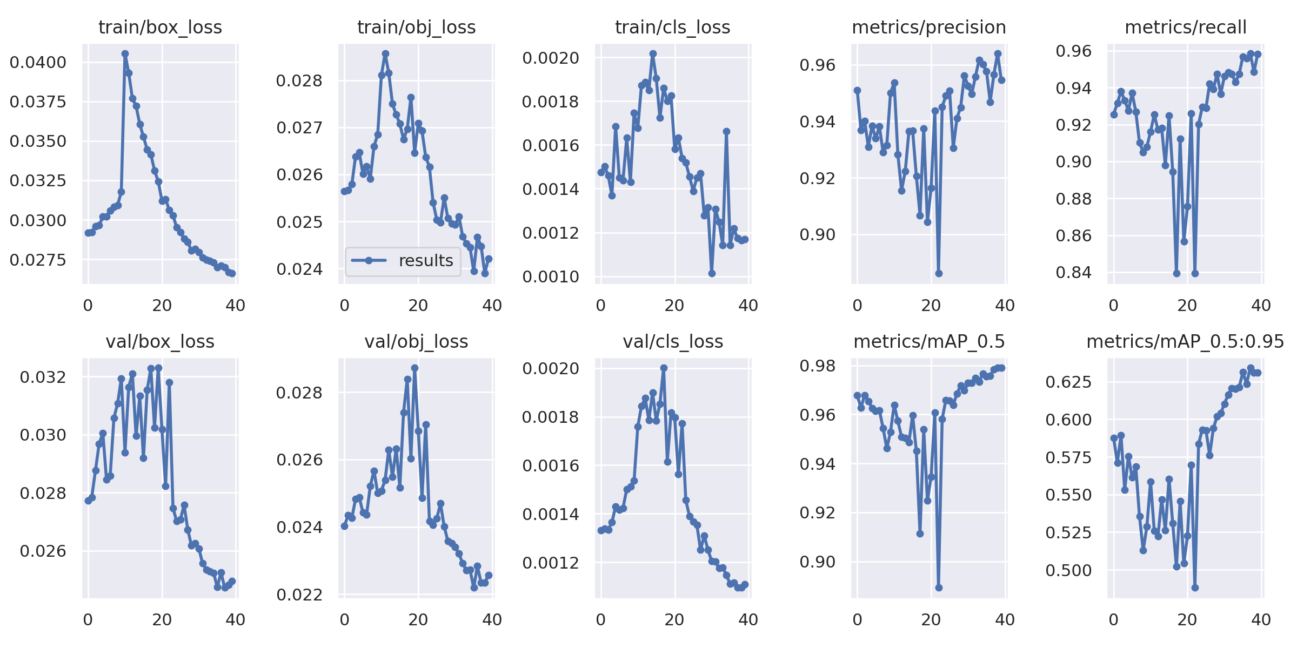
EXECUTATION RESULT
The result of the entire 30 epochs first were visualized in graphs.
The result of the entire 70 epochs later were visualized in graphs.

Slide 23
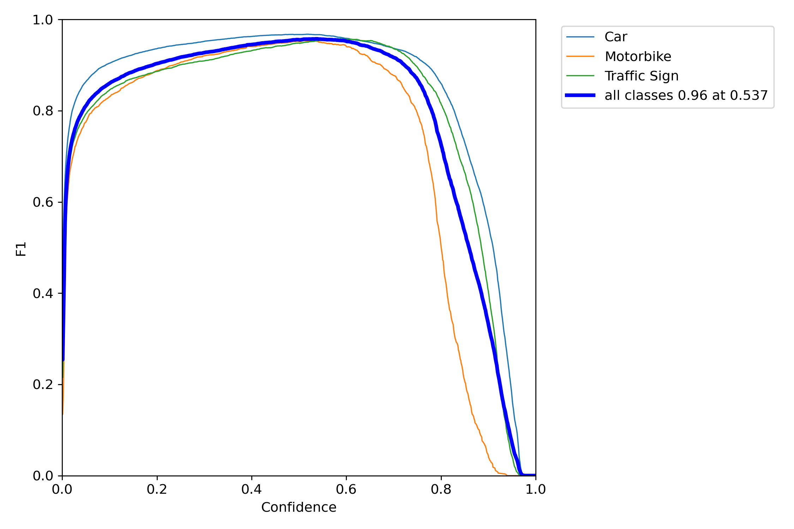
F1-score

Slide 24
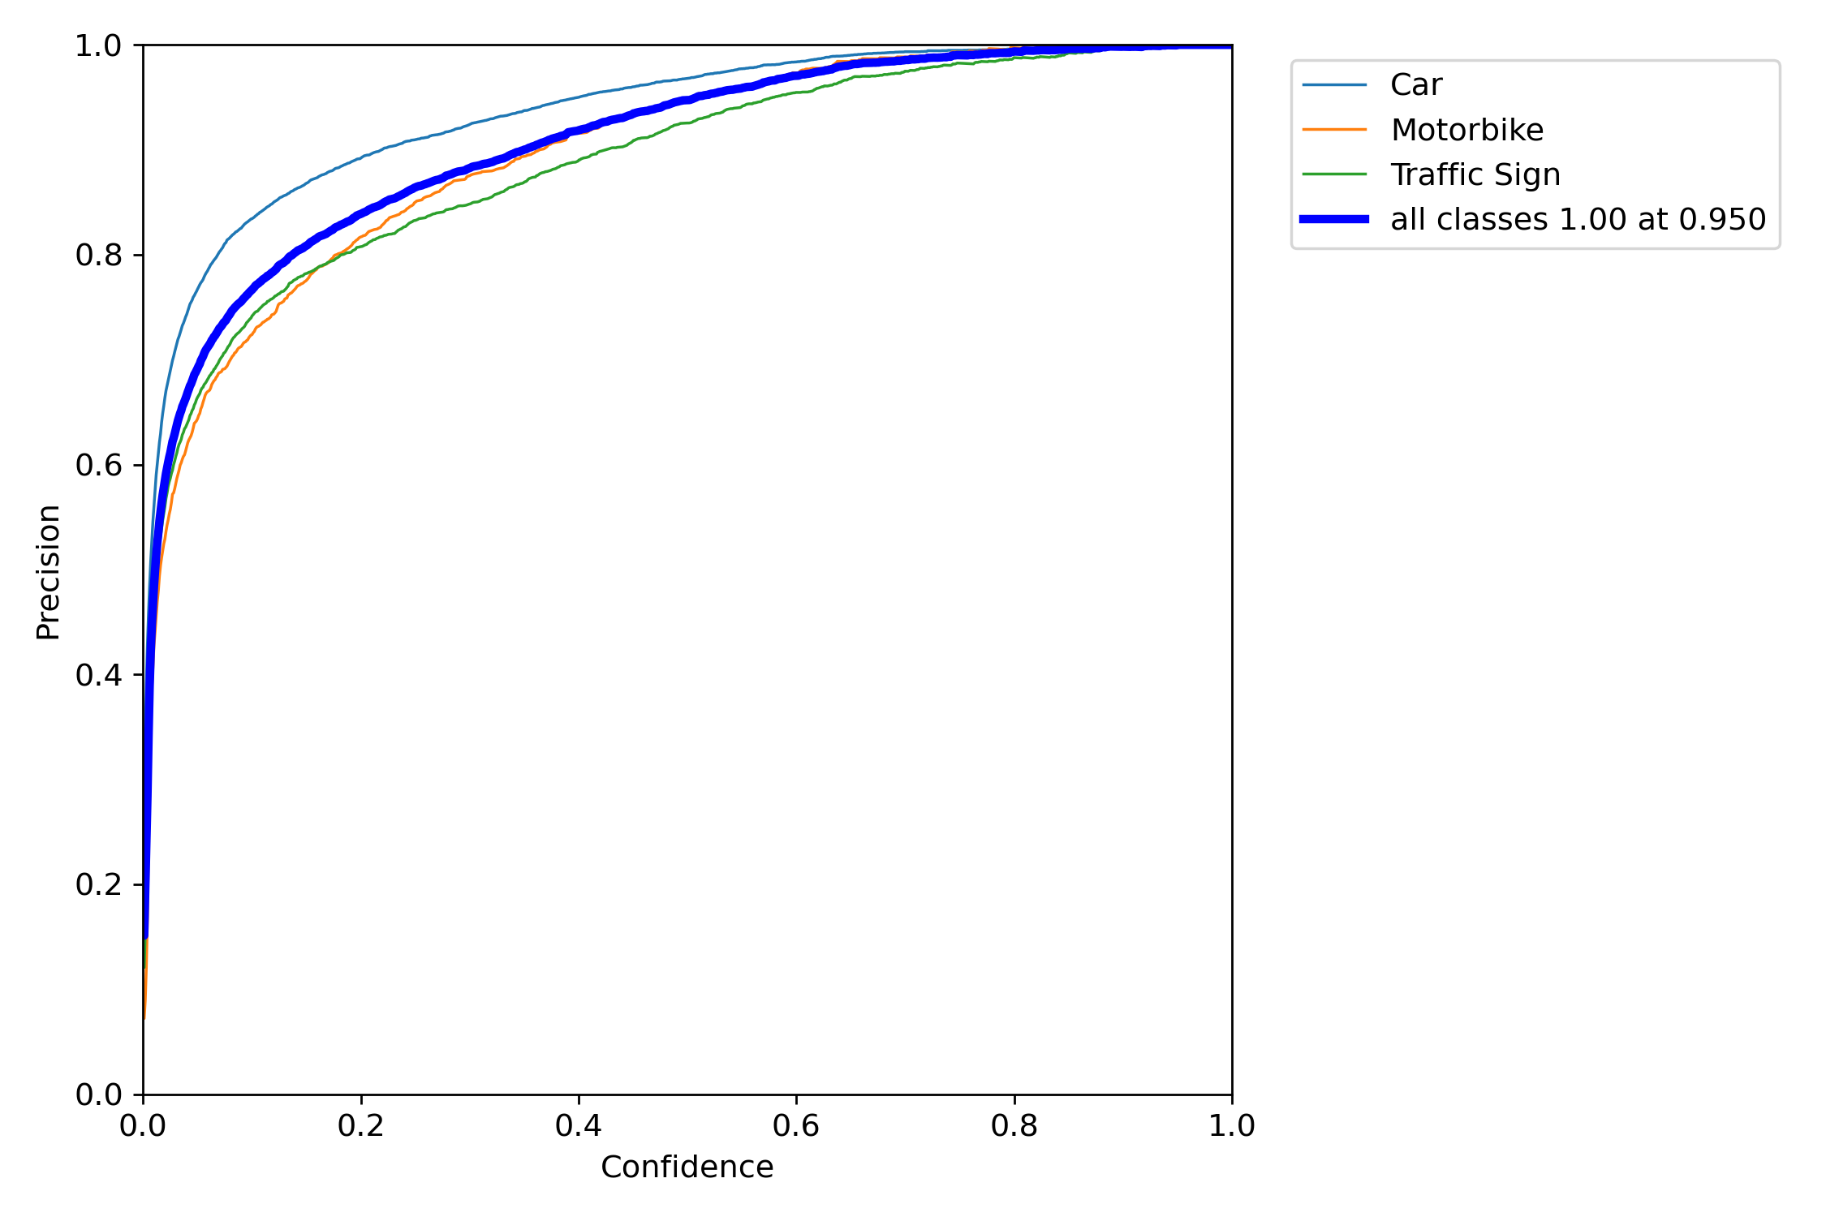
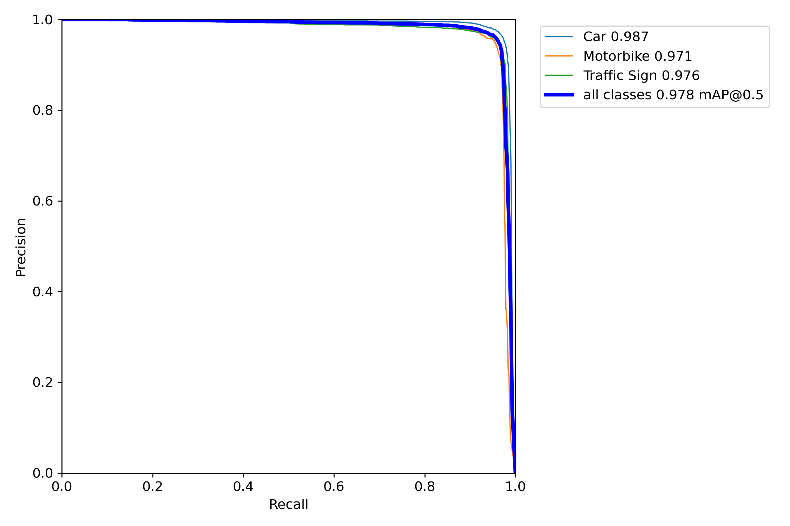
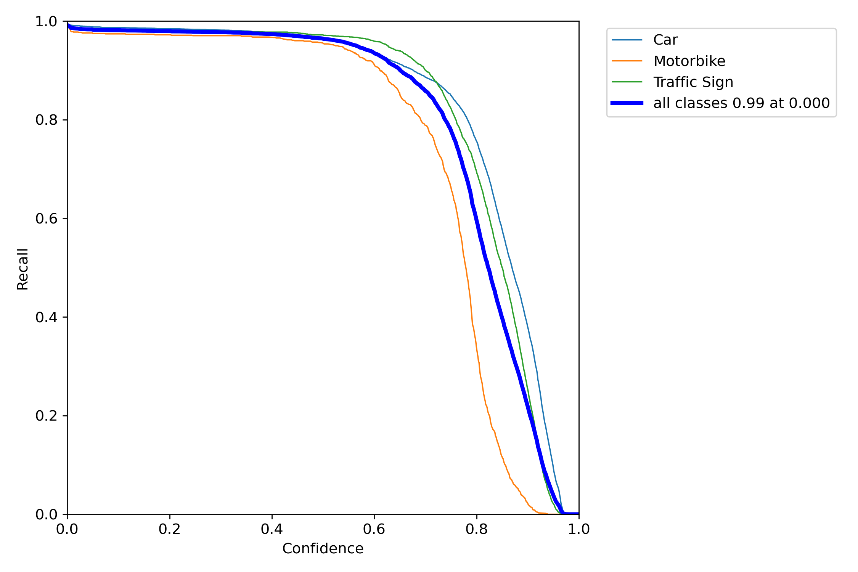
PRECISION-RECALL CURVE

Slide 25
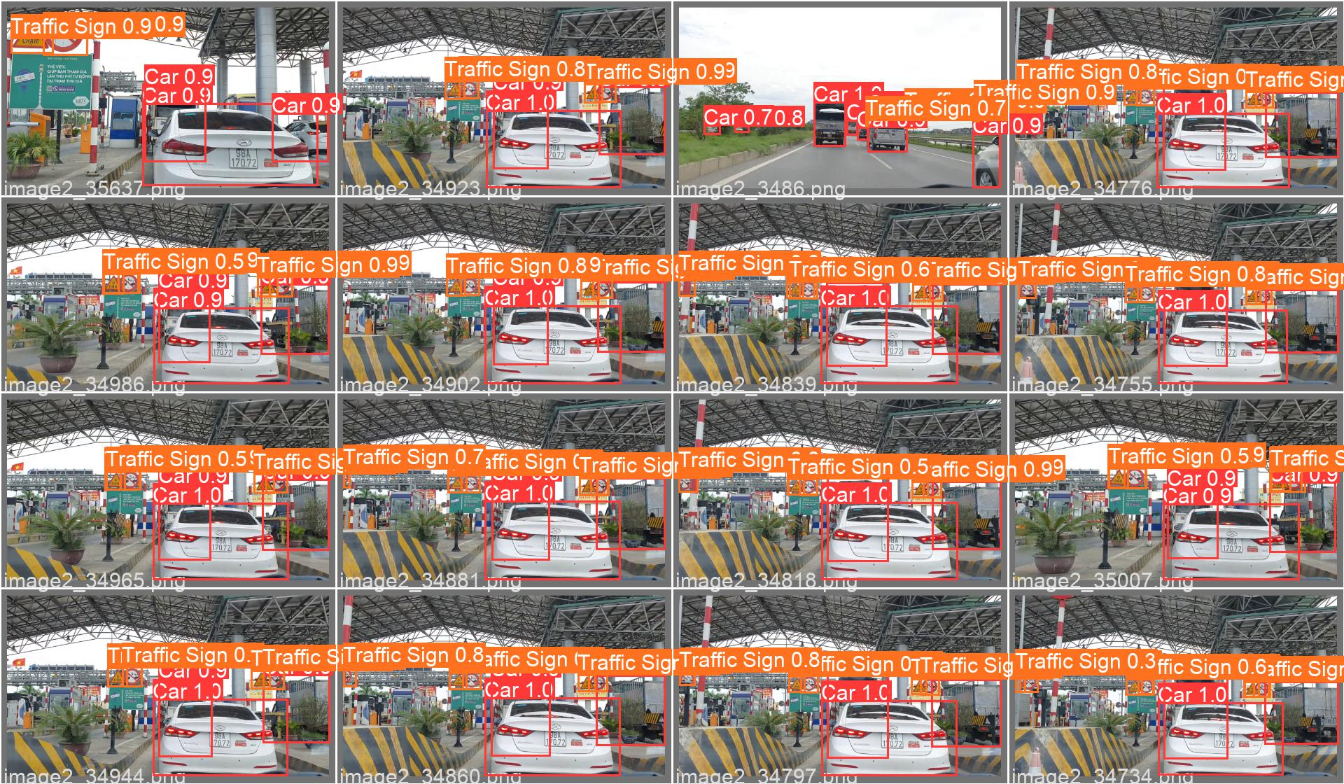
EXECUTATION RESULT
Not only the mAP of VTS are correctly predicted, but the probability for them is also not high.
However, because the model's accuracy was only 97.9%, some VTS were still missing in detection because recall > 0.6

Slide 26
Conclusion
4

Slide 27
CONCLUSION
The mAP of VTS in the video is very high, up to 97.9%
Because of the high accuracy unit matrix in confusion matrix, this is a good module.
Because of using logistic function, vanishing gradient may occur.
The model expenditures up to 5.437 hours for 70 epoches that be tranined slowly and takes more to wait.
Because of not enough GPU to train, the model can not lay out the best mAP for the whole training process.

